Slide 1
Large-scale Graph Mining with Spark
What I learned from mapping >15 million sites
Win Suen
PyGotham 2018

Slide 2
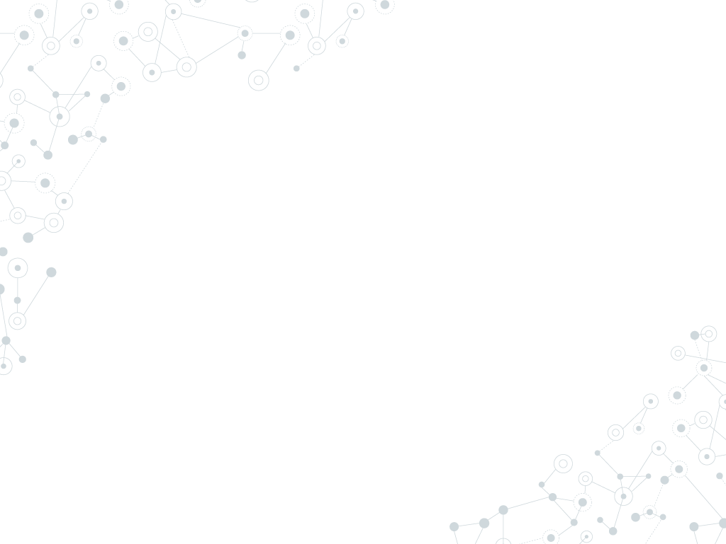

Hello!
I am Win Suen
Data Scientist @ AppNexus (now Xandr).
Avid hiker.
Reader of books and papers.

Slide 3
Agenda
Why?
Labelled data is not always available. Graphs can help.
How?
Find clusters from underlying graph structure, using community detection.
What?
Detect similar sites in large web graph.
Discussion

Slide 4
Graphs 101
Directed Graph

Slide 5
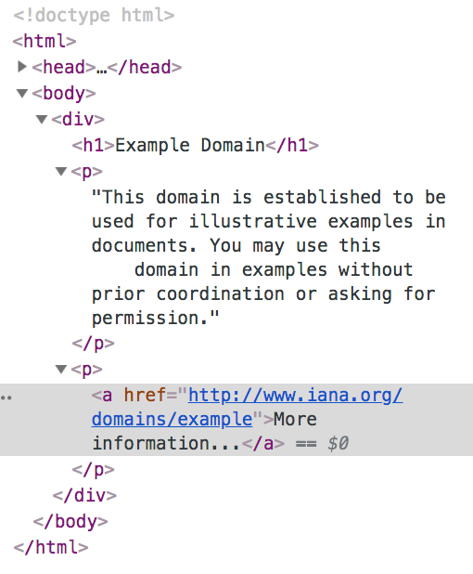
Web graphs
Node: example.com
Directed edge
Node: iana.org

Slide 6
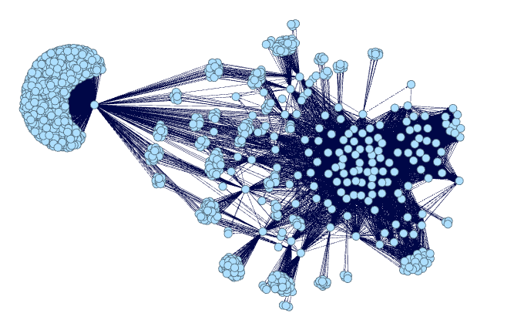
Web graphs: substructures
Subpage structure of a news site, generated by me using Gephi.

Slide 7
1.
Why graphs?

Slide 8
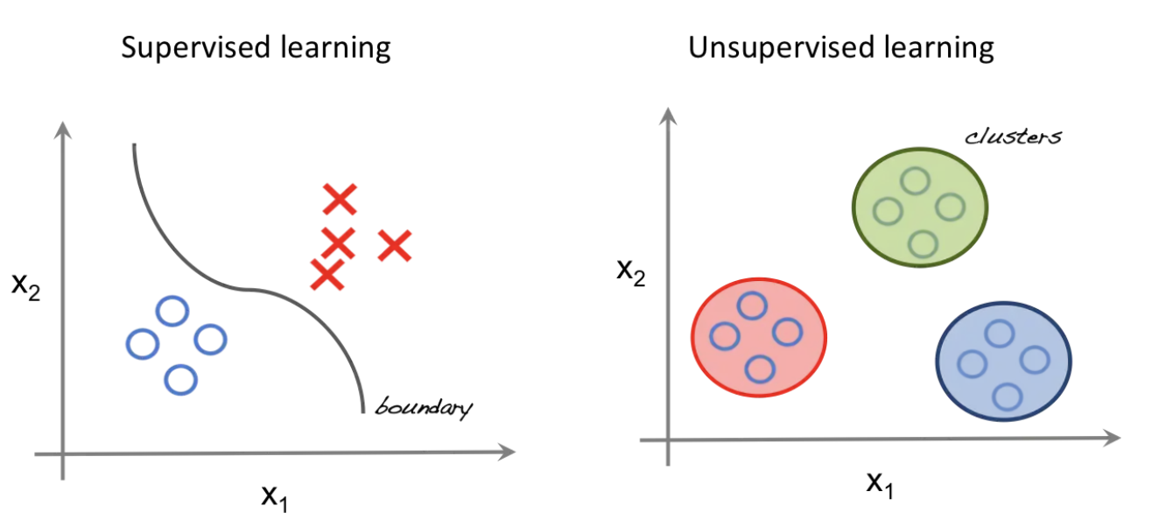
Look, ma! No labels!
http://beta.cambridgespark.com/courses/jpm/01-module.html

Slide 9
Why unsupervised learning?
Data isn’t free.
Labels not always available.
We may not know how many classes of things we are looking for.

Slide 10
How to do this with graphs? → Community detection!
Community
No single, precise definition.
Generally, substructure of a graph where nodes within structure are more densely connected to each other than nodes outside the substructure.
A community is like a cluster!

Slide 11
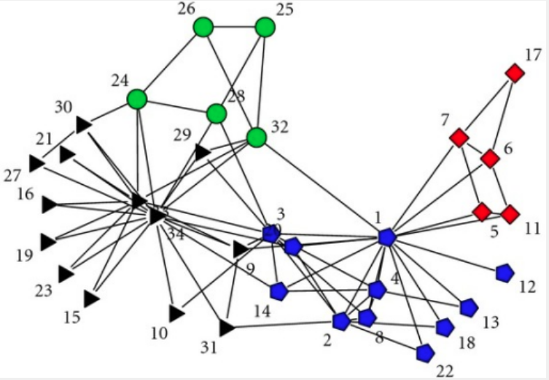
Communities
Zachary karate club dataset -- KONECT, April 2017.

Slide 12
Assumptions
Edges are correlated, not random!
Why?

Slide 13
Assumptions
Edges are correlated, not random!
Why?
Influence: “All my friends are doing it!”

Slide 14
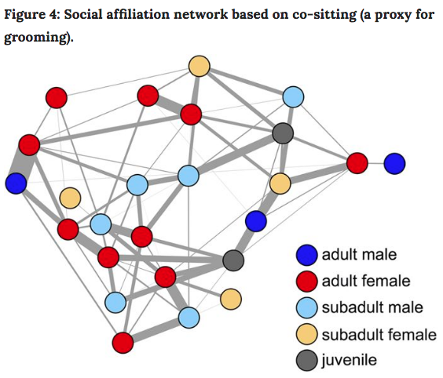
Influence
Farine, Damien R., et al. "Both nearest neighbours and long-term affiliates predict individual locations during collective movement in wild baboons." Scientific reports 6 (2016): 27704

Slide 15
Assumptions
Edges are correlated, not random!
Why?
Influence: “All my friends are doing it!”
Homophily: “Birds of a feather flock together” (aka assortative mixing).

Slide 16
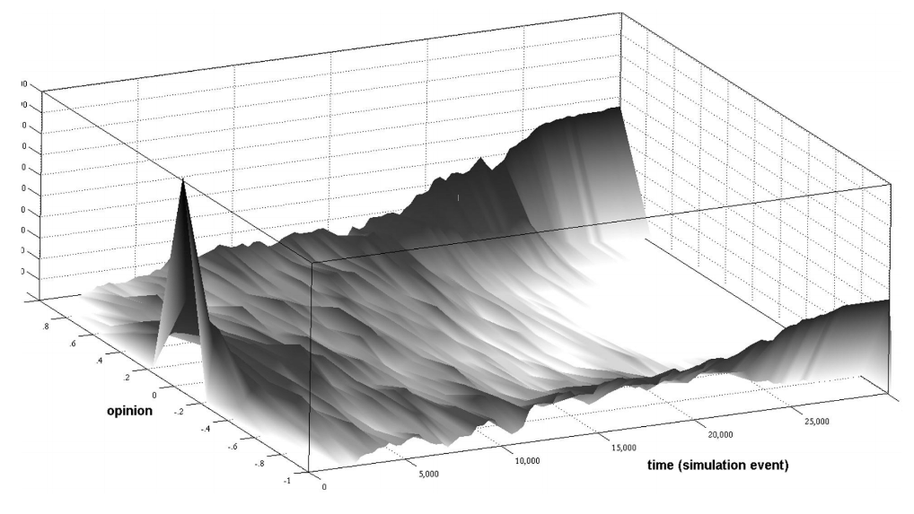
Homophily
Polarization over time
Garimella, Morales, et al, KDD’18.

Slide 17
2.
Community Detection

Slide 18
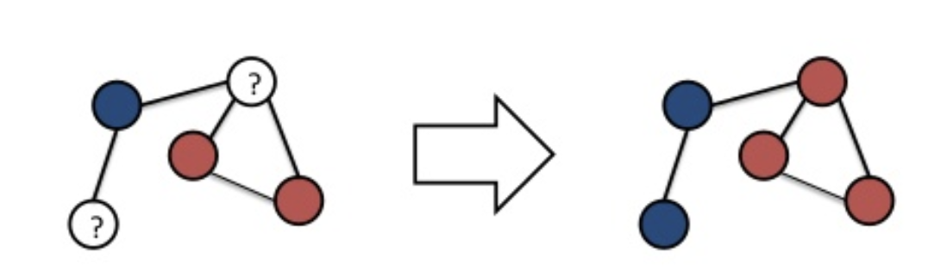
Label Propagation Algorithm (LPA)
Iterative approach. Labels “flow” through the graph.

Slide 19
LPA in action

Slide 20
Advantages of LPA
Labels not required.
External parameter setting is nice, but not strictly necessary.
Runs in near linear time.
Interpretable results.
Raghavan, Usha Nandini, Réka Albert, and Soundar Kumara. "Near linear time algorithm to detect community structures in large-scale networks." Physical review E 76.3 (2007): 036106.

Slide 21
3. Code!

Slide 22
Why choose GraphFrames?
Processes data too large to fit on single machine.
Provides parallelism in processing.
Has some fault tolerance.
Integrates nicely with other python packages.

Slide 23
What I did
Clean Common Crawl dataset. Sample files, write custom parser for warc files, extract links from html.
Load graph into Graphframe.
Filter, clean, repeat. Do this, a lot.
Try to detect communities.

Slide 24
What I‘ll talk about
Clean Common Crawl dataset. Sample files, write custom parser for warc files, extract links from html.
Load graph into Graphframe.
Filter, clean, repeat. Do this, a lot.
Try to detect communities.

Slide 25
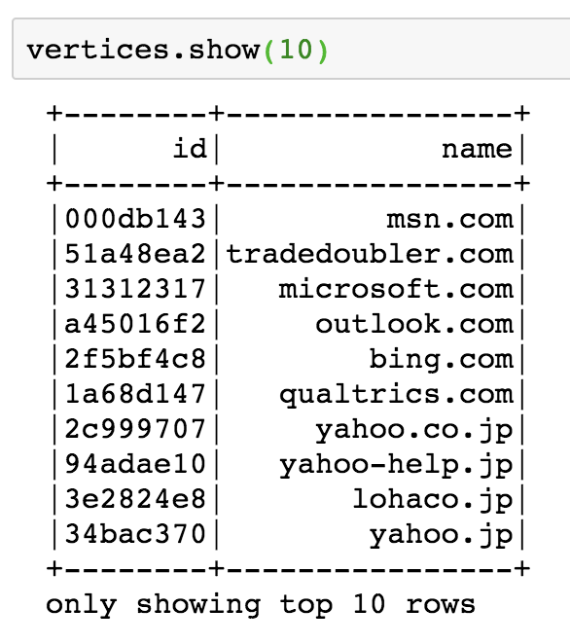
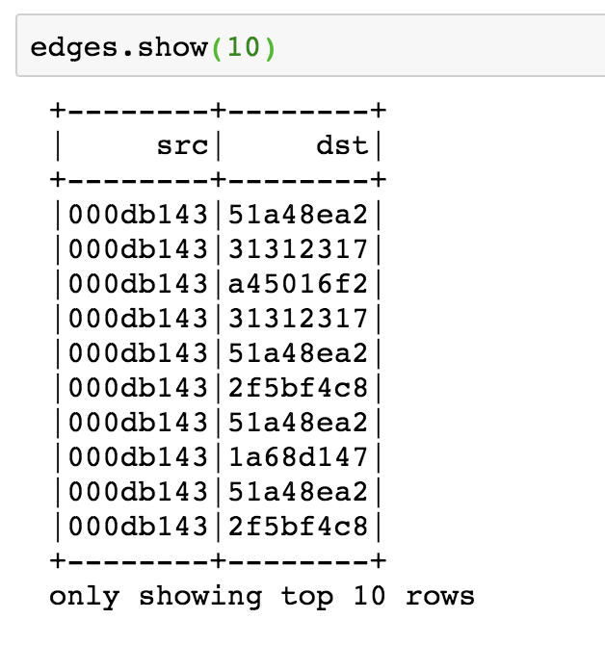
Create GraphFrame

Slide 26
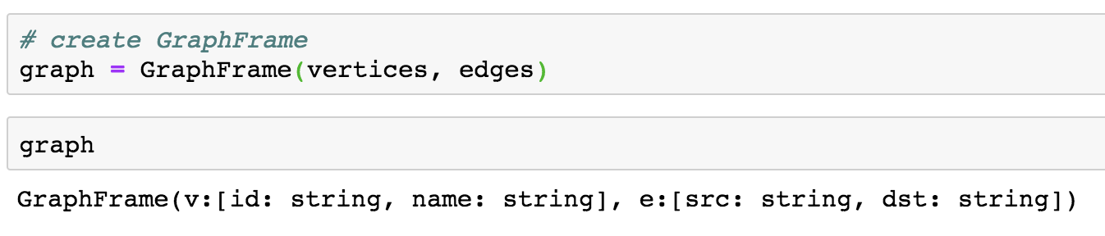
Create GraphFrame

Slide 27
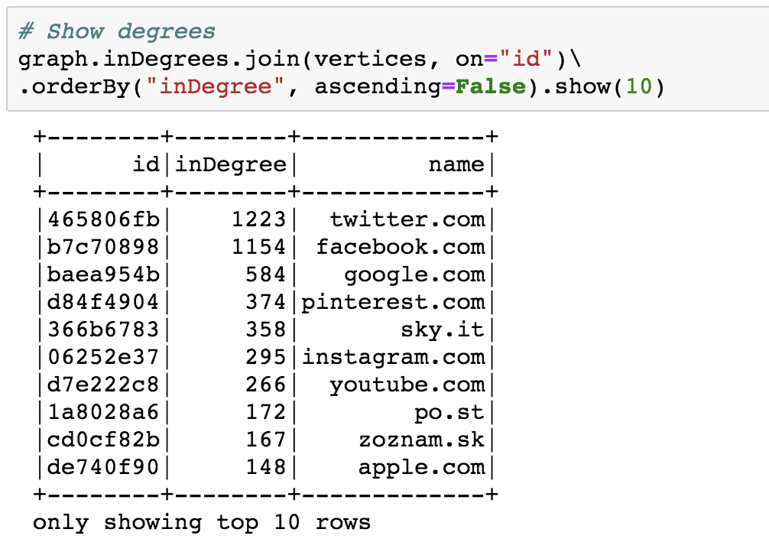
See top nodes

Slide 28
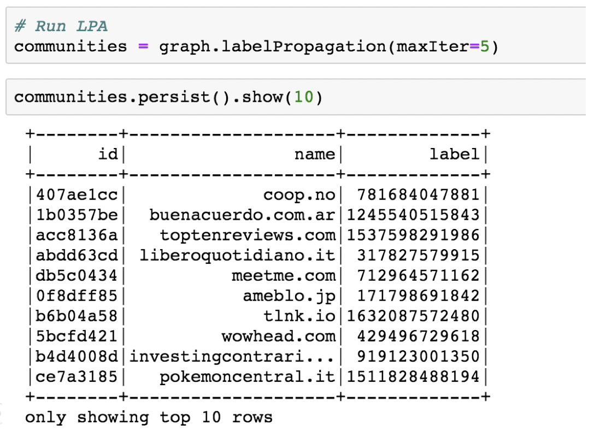
Run LPA

Slide 29
4. Results

Slide 30
> 15 million
4,782
3,573 sites
That’s a lot of nodes. Filter, clean, repeat.
Communities detected
Size of largest community

Slide 31
LPA converges around 5 iterations for sampled Common Crawl data.

Slide 32
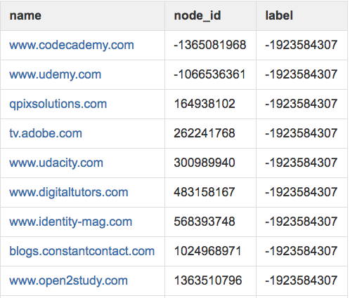
Community: online learning
Mixed community of online learning sites, sites that link to these sites.

Slide 33
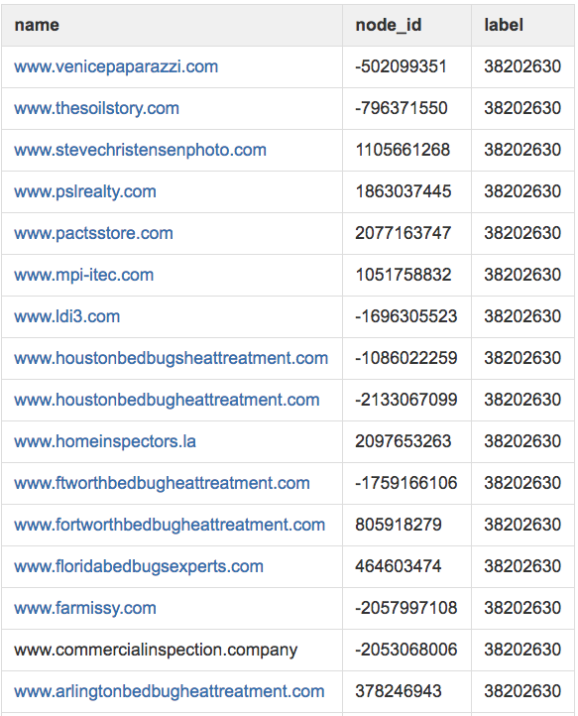
Community: bedbugs
Cookie cutter bedbug sites and sites with similar content resources.

Slide 34
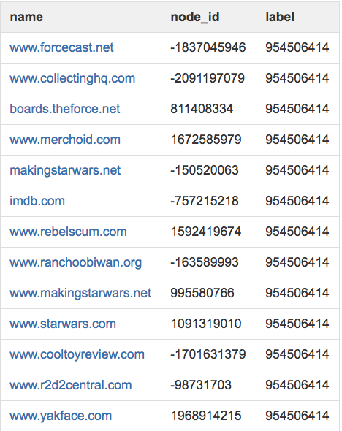
Community: fandoms
Sites related to Star Wars memorabilia.

Slide 35
Applications
Predicting class labels with no previous data.
Recommender for similar sites.
High-level groupings for audience segmentation, classification.
Anomaly detection.
Part of semi-supervised ensemble.

Slide 36
Future Research Ideas
Layer in edge attributes (link types, degree, external metadata, etc).
Monitor nodes of high centrality.
Observe how web graphs change over time.

Slide 37
Obligatory Summary Slide
Graphs very powerful for semi- and unsupervised problems.
Community detection: why and how it works.
Tools, results, applications.

Slide 38
The tip of the iceberg is what I talked about
Didn’t talk about:
Data parsing
Inconclusive results
Trials and many, many errors ☺
See my Medium post (forthcoming) for more gory detail.

Slide 39
Thanks!
Find me at:
wsuen13@gmail.com
Demo:
Tutorial:

